Slide 1

New Student Orientation
School of the Arts
2025-2026

Slide 2





Our Mission is Student Success …
Academic, Artistic, and Humanistic

Slide 3
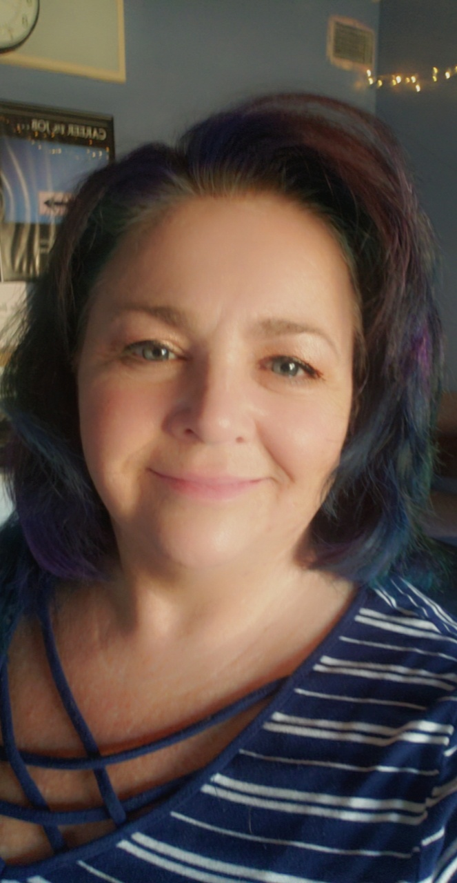
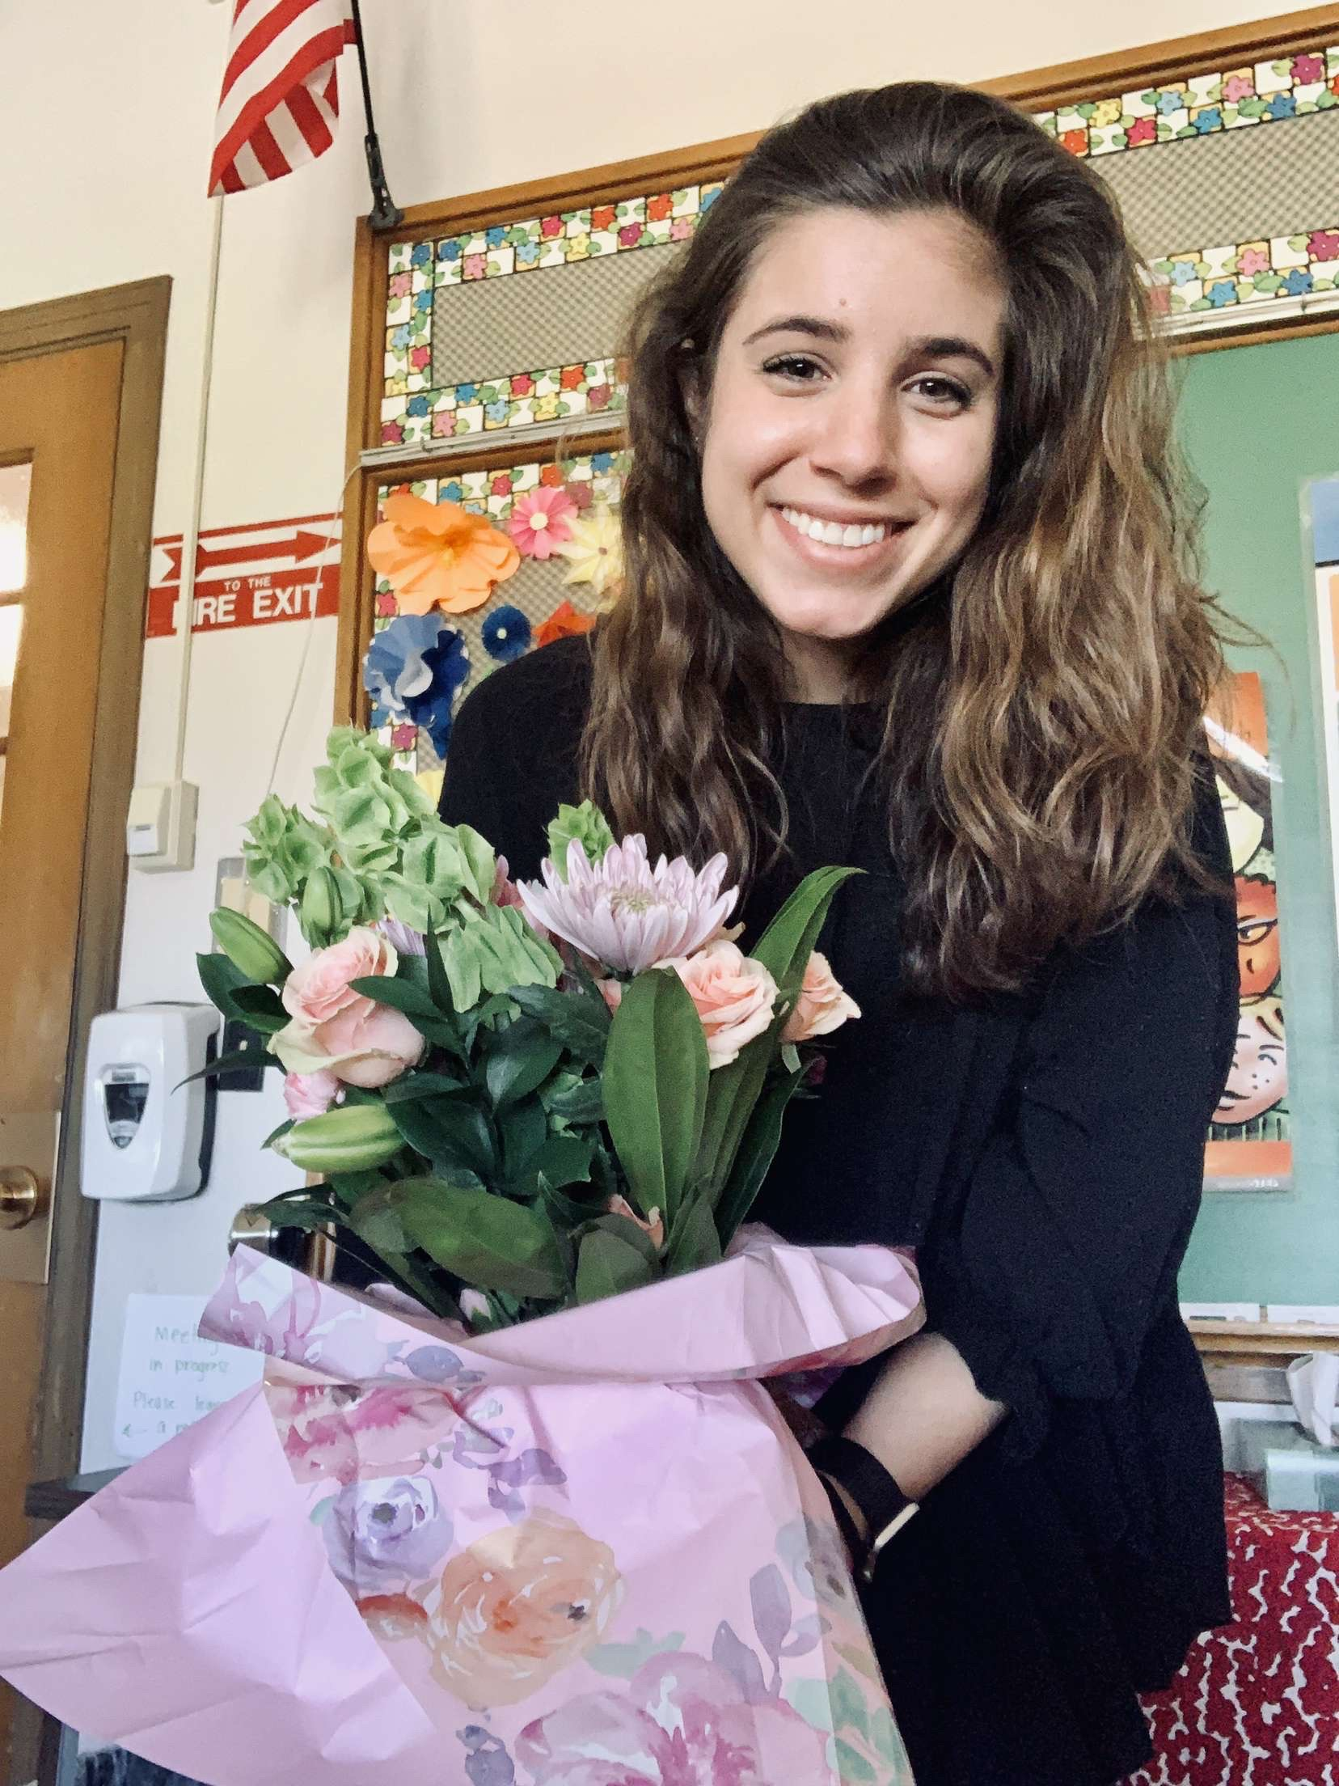
Meet Your Counselors
A- L
M-Z
Mrs. Kelly
Mrs. Everts
Counselor for Last Names M-Z
Grades 7-8
Room A424
sabrina.everts@rcsdk12.org
(585)242-7682 x 4240
Counselor for Last Names A-L
Grades 7-8
Room A432
heather.kelly@rcsdk12.org
(585)242-7682 x4320

Slide 4
School Counseling Services
Consulting and collaborating with students, teachers, parents, administrators and other staff to provide a comprehensive plan focused on the academic and personal success of ALL students
Academic Support
Career Assessment
Crisis Interventions
High School Planning
Classroom Workshops
Small Group Counseling
Referral for Services
Support with community connections
Parent Education
Academic Planning
College Preparation

Slide 5

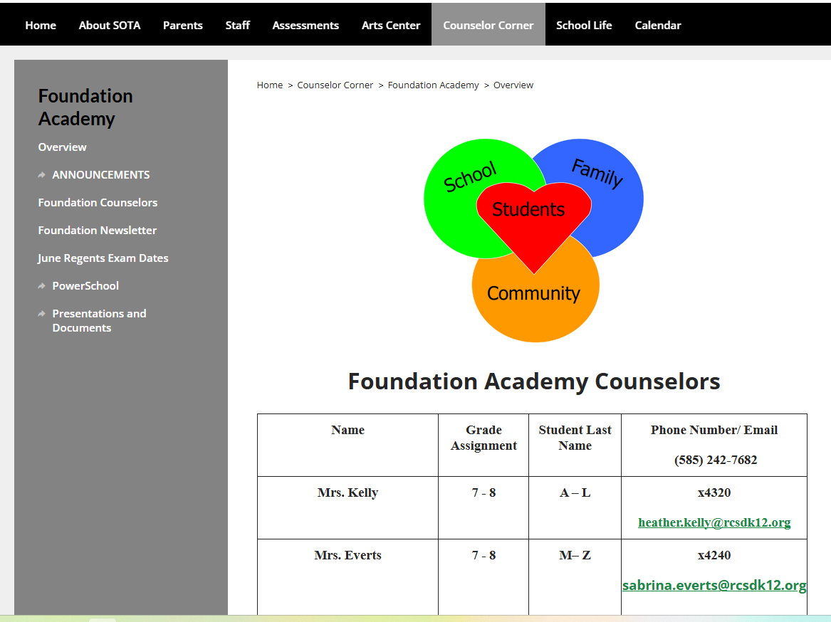
Connecting with the Counselors Information
www.sotarochester.org
Counselor Corner
Foundation Academy
Email
Phone
Appointment

Slide 6
Who Can I Go To When I Need Help?
Center for Youth
Pathways to Peace
Social Workers
School Psychologists
School Counselors
Home School Assistant
Administrators
Teachers

Slide 7

Meet Your Social Workers
Mrs. Brandie Johnson Grades 7-9
brandie.johnson@rcsdk12.org
Mrs. Jasmine Coley-Gordon Grades 10-12
jasmine.coleygordon@rcsdk12.org
Ms. Loralee Lindsey Crisis and on-call services
Loralee.Lindsey@rcsdk12.org

Slide 8
Social Worker Services
Advocate for students emotional needs
Support students in Special Education
Implement Individualized Educational Plans for counseling
Provide support for students to access outside community resources
Promote student success at home, community and school.

Slide 9
Meet Your School Psychologist
Joshua Blumkin
joshua.blumkin@rcsdk12.org
Grades 10-12
Jason Dingman
Jason.Dingman@rcsdk12.org
Grades 7-9

Slide 10
School Psychologist Services
Assess learning, behavior, and emotional needs.
Provide short-term counseling and student support.
Assist during crises and urgent situations.
Support IEPs and 504 Plans.
Create behavior improvement strategies.
Monitor student progress and outcomes.

Slide 11
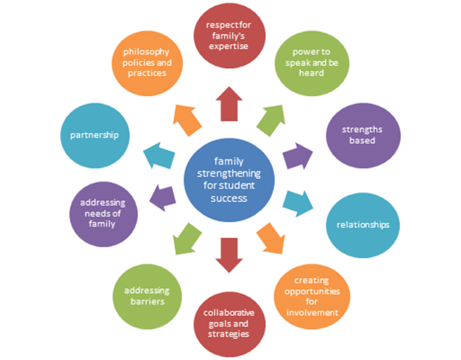
Home School Assistant
Leslie Hunter, MS MHC Lesliea.Hunter@rcsdk12.org
Ms. Hunter works with students and
families around issues that negatively impact student impact
impact student attendance and
learning.

Slide 12
Home School Assistant Services
Home visit to students and families
Builds family-school relationships
Offers save space for real time support for conferences, and resolution of parent and student concerns, including mediations
Collaborates with or makes referral to community partners, including MC Fact, Mental Health Providers, CHUNNY, Youth Programs, and Department of Health Services
Shares school based and district wide supports and offerings.

Slide 13
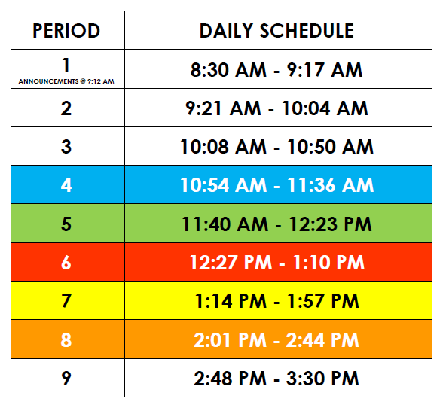
Daily Schedule
The academic day at SOTA is nine (9) periods long.
There is a four day rotation cycle, days A, B, C and D
Daily attendance is taken in every class.

Slide 14
Student Schedule Information
Term:
The length of time in which the class is held.
Full Year (25-26)
Semester I (S1) or Semester 2 (S2)
Quarter (Q1, Q2, Q3, Q4)
Meeting Pattern:
The class period (time) and day the class meets.
Every day
Every other day
Every four days

Slide 15
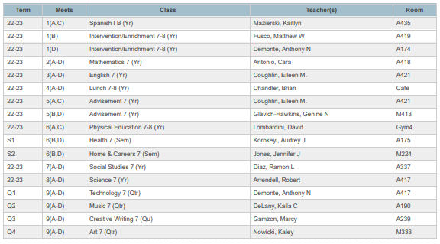
Example Student Schedule
1(A,C) = Class meets every other day Period 1 (8:30am - 9:17 am) on A and C days only
1(B) or 1(D) = Class meets Period 1 every 2nd or 4th day on B or D days only
7(A-D) or 8(A-D) = Class meets every day period 7 or period 8

Slide 16
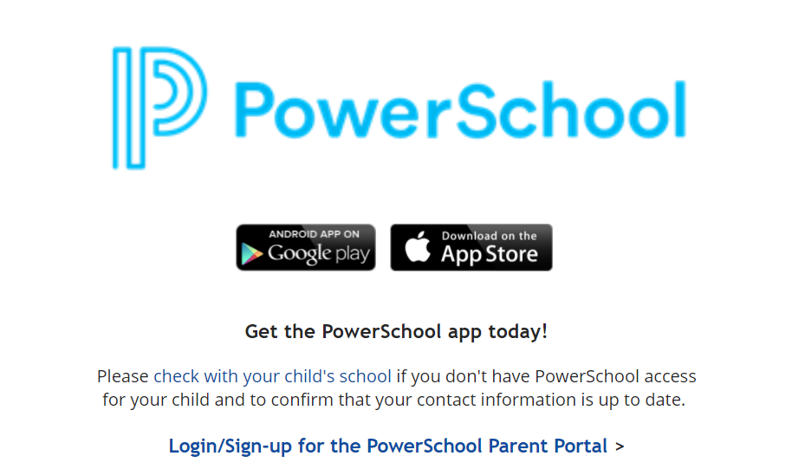
To stay in the loop on your scholar’s grades:

Slide 17
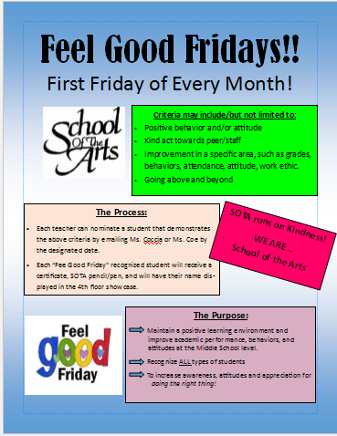

Great Things Happening at SOTA!
Feel Good Fridays - The first Friday of every month
Student incentives: SOTA Superstars, field trips, dances, field days
Honor Roll Recognition - At the end of 1st, 2nd & 3rd quarter
SOTA Stream- Daily announcements hosted and produced by SOTA students
Ice Cream Sales
Clubs and Activities - Can be found on SOTA webpage
Student Performances
Sports
Notes:
Chandler

Slide 18

SOTA Standards
“The standard is the standard”
Mike Tomlin~Head Coach, Pittsburgh Steelers
An appropriate environment must be present in order for students to realize their full potential in satisfying our mission of ‘Student Success…Academic, Artistic and Humanistic.’ This environment is created through expectations (standards).
“The standard is the standard” essentially means that the expectations (implemented to achieve an appropriate learning environment and ensure student success) are expected to be upheld by ALL members of the SOTA community. The expectations are unwavering. Your buy-in is required.
Let’s take a look at some of the expectations of students at SOTA.

Slide 19
Scanning Expectation
The Rochester City School District utilizes metal detection systems, including hand-held wands, walk-through and x-ray capacity equipment and may be used by trained personnel at any school in a random manner, and may be done on a non-random basis premised upon reasonable suspicion. All students are subject to scanning procedures, and to confiscation of any material prohibited by law, school district policy, or regulation.
RCSD CODE OF CONDUCT CAN BE FOUND HERE

Slide 20
Scanning Expectation
Students are required to carry their student identification, and to present it upon request to any District official or employee.
All self-carry medications must be on file in the Nurse’s office.
Items deemed inappropriate are at the discretion of the administration. Inappropriate items are, but not limited to vaping devices, glass bottles, permanent or Sharpie Markers, scissors and lighters.

Slide 21
Timeliness Expectation
“Early is on time, on time is late.”
Students are expected to report to all classes, including lunch, on time.
Tardiness will be a determining factor in a students eligibility for incentives throughout the year.
Being on time is a life skill to learn now!
Notes:
Add more here?

Slide 22


Cell Phones, Smart Watches, Tablets and all personal Smart devices.
Our expectations have not changed and will be facilitated using secure Yondr pouches.
SOTA is committed to maintaining a distraction-free, learning-centered environment in alignment with NYS Educational Law.

Slide 23

Responsible Cell Phone Use
It means that you have your Yondr pouch every day you come to school.
It means that you are compliant with school expectations for storing your cell phone in your Yondr pouch during the school day.
It means that you engage in responsible habits (with respect to your cell phone use -in and out of school) that only promote positive school culture.

Slide 24
Student Conduct
An appropriate environment must be present in order for students to realize their full potential in satisfying our mission of ‘Student Success…Academic, Artistic and Humanistic.’ This environment is created through structure.
Students are expected to exhibit appropriate behavior in all locations of the building. Administration will evaluate student behavior, and when necessary, apply consequences consistent with the district Code of Conduct.
“Structure is love”

Slide 25
Birthdays
Should be celebrated outside of school
Food, balloons, celebratory items should not be brought to school. Parents should not bring these items to school for their child either.
Some concerns are food allergies and disruptions to the school day

Slide 26
Chromebooks
Student Google accounts should only be used for academic purposes
Gaggle incidents may result when students use their Google accounts as their personal communication account
Can lead to frivolous investigations and parent contacts

Slide 27
Transportation
Letters with details indicating bus numbers and routing info will be mailed the last week of August. This will serve as your temporary bus pass.
Service will be provided via RTS to the stop nearest to your house.
School of the Arts does not have supervision or provide transportation for unsanctioned after-school activities. Therefore, all students must exit the building at dismissal and take their designated transportation home.

Slide 28
Students Riding RTS for the First Time
Many well-intended parents drive children to school on the first few days. While this may help to deal with the anxiety your child may have about this process, it actually delays their adjustment to riding RTS.
Students acclimate quickly to the process of navigating RTS bussing by simply going through the process.
Dropping students off also adds additional traffic congestion, and often creates an unsafe environment during arrival and dismissal on Prince Street.

Slide 29
Helpful Transportation Tips
Take your child to their bus stop prior to the first day of school. Familiarize them with how to get to the stop and identify their bus. If possible, also do this the first day of school.
Have your child take a picture of the transportation letter and save it on their phone (if they have one). If not, create a note card for them with their name, address and bus number on it. Put this in their bookbag. Show this information to an adult at dismissal.
Students will take the same bus home as they took in the morning. This is generally the case for most students, unless they need to go to a location other than home after school.
Stay calm and find an adult if you can not find your bus at dismissal. No child will be left without a ride, and we will work with them until we find the bus they need. THIS IS WHY IT IS IMPERATIVE THAT WE HAVE MULTIPLE CONTACT NUMBERS.

Slide 30
Please Direct Transportation
Related Inquiries To:
RCSD Transportation Department
835 Hudson Avenue, Bldg. 1
Rochester, NY 14621-4897
Phone: (585) 336-4000
RTS Customer Service
(585) 288-1700

Slide 31
Links to Important Transportation Documents
RTS Presentation for School of the Arts Orientation
How to Use Neighborhood Direct Service
Neighborhood Direct Service - Printable Flyer
Tap-Beep-Take Your Seat Flyer
Boarding Locations and Block Assignment

Slide 32
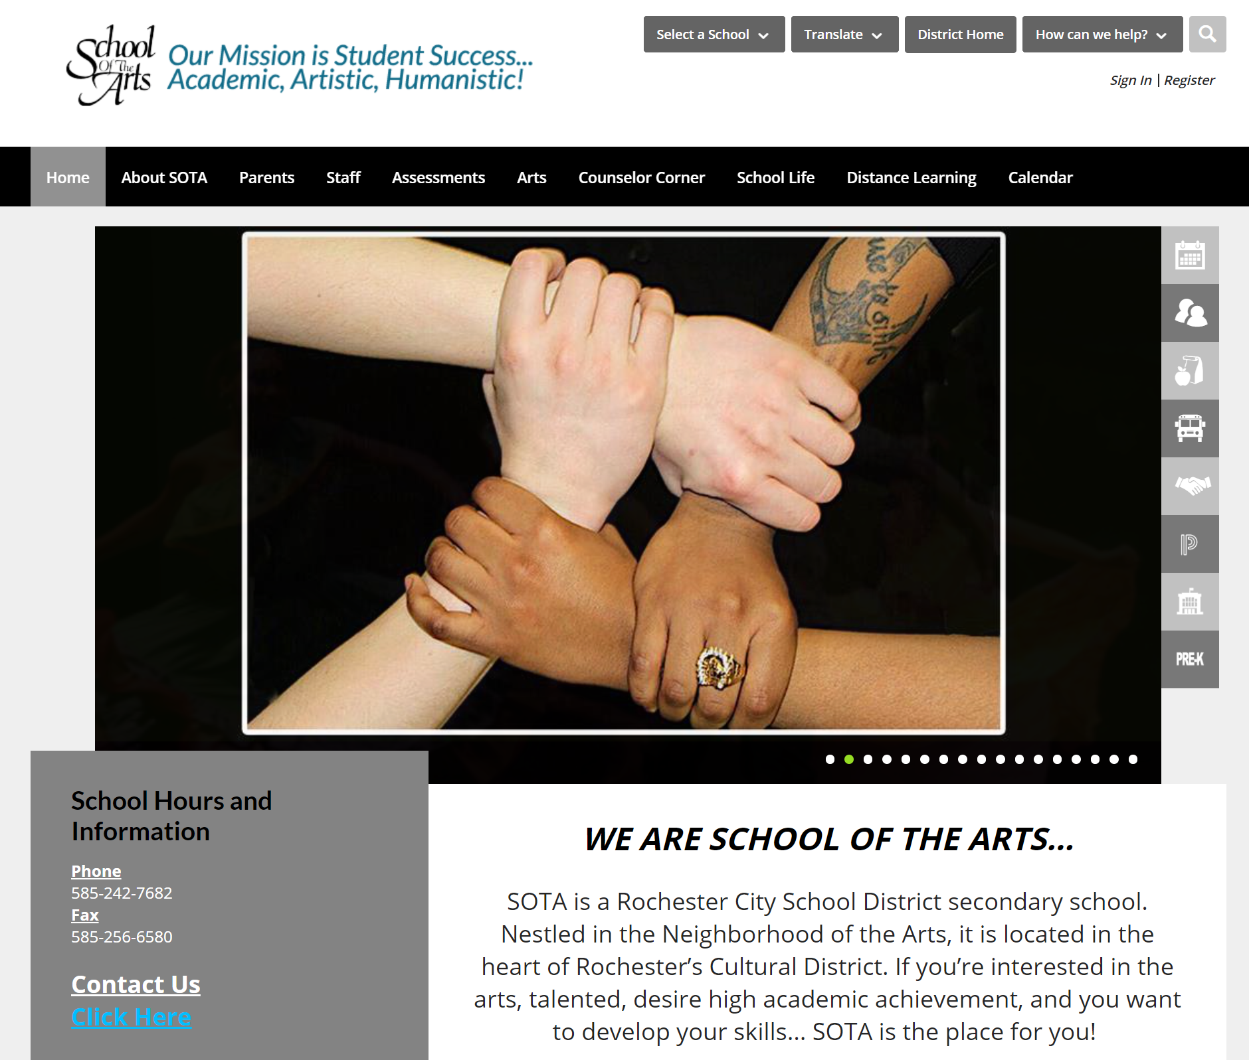
SOTA’s
Website
www.sotarochester.org

Slide 33
New Student Orientation
Parent Presentation

Slide 34
To parents, we can't tell our kids to do well in school and then fail to support them when they get home. You can't just contract out parenting. For our kids to excel, we have to accept our responsibility to help them learn.
That means putting away the Xbox, putting our kids to bed at a reasonable hour. It means attending those parent-teacher conferences and reading to our children and helping them with their homework.
President Barack Obama, July, 16, 2009
Notes:
Tirre

Slide 35
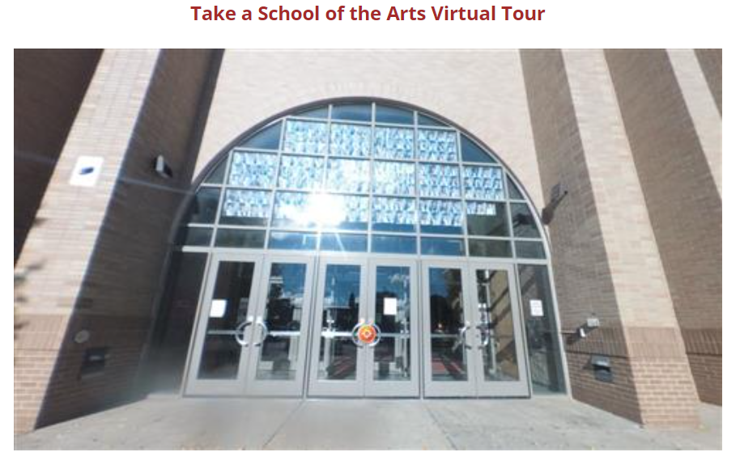
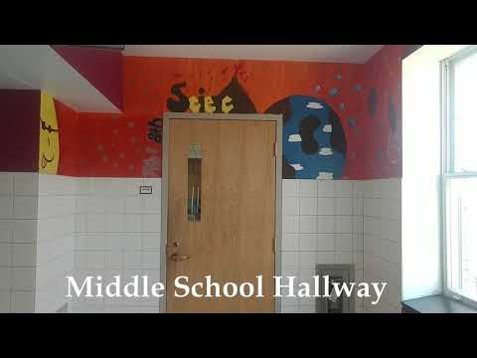
Student Tours
Click here to take a
Virtual Tour of our building.
Students in Grades 7 and 8 can learn
how to get to their first period classes
by clicking on this video.

Slide 36

Visitor Policy
Your child’s safety is a top priority, and I want to provide some information on the established procedures for visitors in our schools. They are in place to protect students and staff, and all visitors must adhere to these regulations. Anyone who does not adhere to these procedures will not be permitted entry.
Notes:
Tirre

Slide 37
Visitor Policy
Please call ahead for an appointment so the person you want to meet with is available.
The school’s main entrance will serve as the single point of entry for visitors. Visitors must report immediately to the security desk and present photo identification to obtain a visitor’s pass.
Parents/caregivers must call the school office to arrange an early pick up time for their children and present photo identification upon arrival.
Visitors are subject to security check of their person and belongings. Anyone refusing will not be allowed to remain on District property.
Any person asked to leave school property must do so immediately. Refusal to leave will result in additional intervention.
Notes:
Tirre

Slide 38
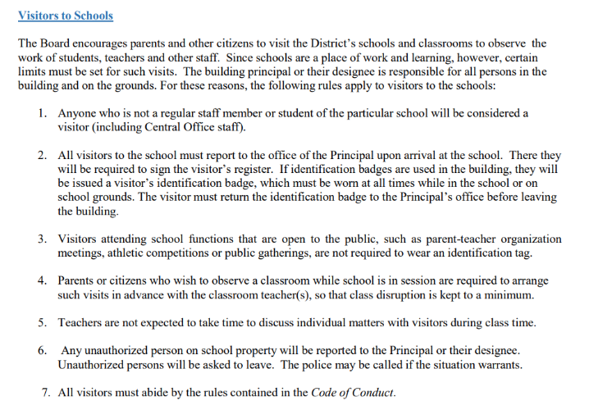
Visitor Policy
Notes:
Tirre

Slide 39


Communication
SOTA Stream Announcements
Website
Newsletter by email
Facebook
Instagram
Notes:
Tirre

Slide 40

Important Things to Know
Safety and Security
Chromebooks
The three L’s
Special Education
Notes:
This needs to be more specific (?)

Slide 41

How to be a Successful
SOTA Student
Give your best effort!
Bring your best self
Participate in class
Come prepared for class every day
Plan a consistent daily study time for homework, classwork and tests!
Ask for help when needed
  Parents, Teachers, Counselors, Administrators
Attend each class, on time, every day!
Take advantage of SOTA resources
Use your cell phone, the internet and social media responsibly!
Notes:
Tirre

Slide 42
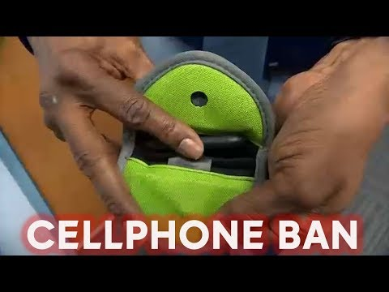
Cell Phones will be put into YONDR pouches before scanning. Pouches will be unlocked at dismissal.

Slide 43

Updating Contact Information
Updating family contact information is critical. Schools must be able to reach parents when necessary. Please visit SOTArochester.org, look for the icon below to make any changes to your contact information.
Notes:
Tirre

Slide 44

Student Use of Food Delivery Services
During Lunch is Strictly Prohibited

Slide 45
ATTENDANCE
EXCUSED ABSENCE
ILLEGAL (UNEXCUSED) ABSENCE
Student Doctor or Dentist appointment
Funerals
Illness
Student Mandated appointment
College visit
Religious holiday
Family vacation
Attending non-school based competitions
Going to work
Babysitting a sibling
Notes:
Brody

Slide 46
Missing school can lead to:
Failure to acquire basic skills for the grade level the student is enrolled in or progress within their arts major.
Low or failing grades at the end of a marking period.

Slide 47
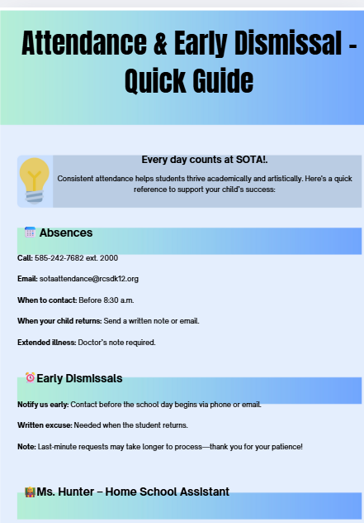

Ms. Hunter supports families with:
Long-term absences (3+ days)
Punctuality or full-day attendance challenges
Collaborative problem-solving with families and service providers to promote consistent attendance
Contact: 585-242-7682 ext. 3421
Leslie A.Hunter@RCSDK12.ORG

Slide 48
Athletic Information
Notes:
Roche

Slide 49
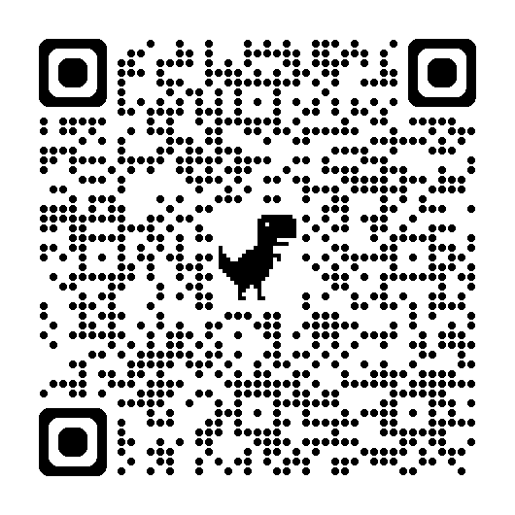
What do you need to do to play a sport?
Arbiter Sports (Family ID) registration is open 30 days prior to the season start date
Arbiter Sports Registration Process
https://students.arbitersports.com/rochester-city-school-district/school-of-the-arts-fall-2025-varsity-jv-modified-athletics
Have an updated physical - within one calendar year
Once the nurse approves a student
a notification will be sent to the coach

Slide 50

Academic Eligibility
Eligibility Criteria:
Maintain a C average (2.0 GPA) in all subject areas.
Maintain daily class attendance in all subject areas
Demonstrates good school and community citizenship
In determining continued eligibility, the official report card is the basis. Students on probation are eligible to participate with 1 F and must attend academic tutoring 2 times per week for 3 weeks. Students that are ineligible with 2 or more F’s can’t participate in any games but are eligible for practices and must attend tutoring 2 times per week for 3 weeks.

Slide 51
Lockers
Locker Assignments:
Students in grades 7 and 12, as well as dance majors in grades 9-12, will be assigned individual lockers.
Students in grades 8 through 11 will share lockers with a designated peer. Done by request only.
Distribution of Combinations:
Locker assignments and combinations will be emailed directly to students’ RCSD Gmail accounts.
Reporting Issues:
Locker issues are to be reported using the Google Form link provided in the locker assignment email.
Important Reminder:
Locker combinations are not to be shared with anyone.

Slide 52
Luke Wilson, 9th Grade Assistant Principal
Background: 18 Years in Education, Former Music Educator, Product of the Arts
Responsibilities: Arts Liaison, 9th grade AP, Supervision of Math and Drama Depts., Student Teachers, Attendance, Productions, Lockers, Substitutes, Audition Process
Goal: “The Standard is the foundation on which we build upon.”
Contact:
Email: luke.wilson@rcsdk12.org
Office #: 585-242-7682 x6111
Location: M150

Slide 53
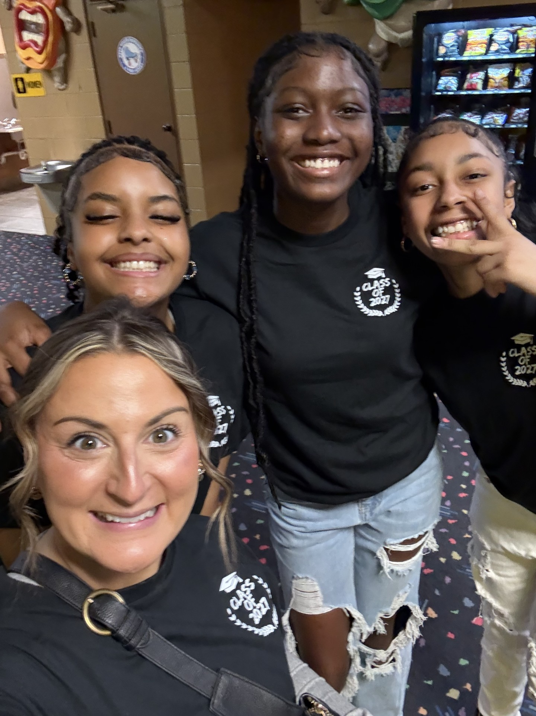
Dr. Emily McCord
Academy Director
Grade 11 & 12 Administrator
Role: Creative Writing, English, MTSS, Professional Development, Testing, Coaches, Title I, Instructional Data/Plans, Social Studies, Academic Programming, Teacher Work Groups
Contact Information:
Email: emily.mccord@rcsdk12.org
Office: 585-242-7682 x 3000
Location: 3rd floor House Office

Slide 54
Questions
Send Questions to:
SOTAinfo@rcsdk12.org

Slide 55
Thank you for your attendance and welcome “home”. #SOTASTRONG
See you in September!
(585) 242-7682
sotarochester.org
Send Questions to:
SOTAinfo@rcsdk12.org

